Slide 1
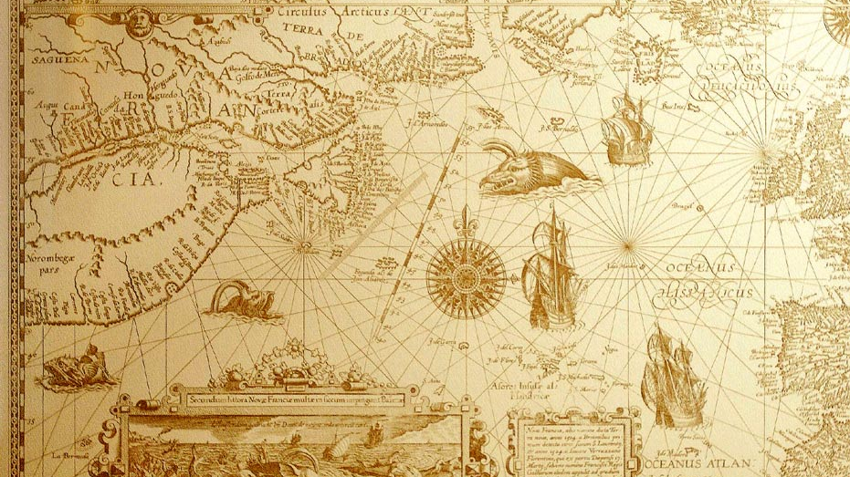
HERE BE DRAGONS…

Slide 2
Engineering design 2026
Welcoming and introduction
Prof Henri Marais
15 Jul 2025

Slide 3
Module admin
Lecturer, modalities, assessment

Slide 4

Lecturer Info
Prof Henri Marais
Professional Computer/Electronic Engineer (PrEng)
Associate Systems Engineering Professional (ASEP)
Consulting Design Engineer (10+ years)
Embedded (electronics / firmware)
Software (operational excellence)
Diagnostics / remote monitoring

Slide 5

How to get in touch
Whatsapp Group (details to follow)
Run as a business account during office hours only
Email
General queries (henri.marais@nwu.ac.za)
Clearly indicate module code in the subject line
Turn time +/- 48h
Office
N1A-235
Make an appointment before dropping in outside of consulting hours
Consulting hours posted on eFundi and my office door

Slide 6
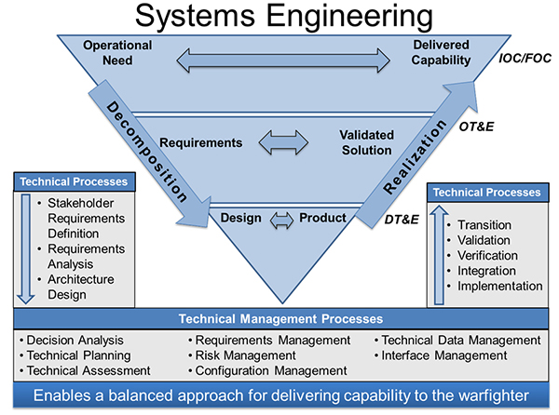
Systems engineering based
In this module you will be exposed to:
Requirements elicitation (what to do, how well)
Requirements development / documentation
Interface allocation, design, documentation, and control
Specialist engineering
Integration and testing
Documenting detail engineering activities
Presenting solutions

Slide 7
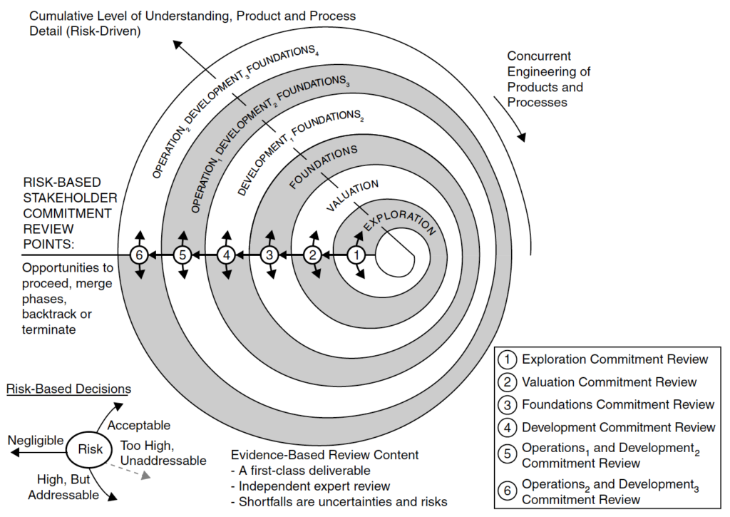
Incremental commitment spiral model (ICSM)
Risk based
Each increment adds meaningful value / progress

Slide 8
PRESENTATION TIMELINE
Increment | Weeks | Duration | Primary Focus
I1 — Discovery Sprint | 2–3 | 2 weeks | Scoped experiments, first estimation cycle
I2 — Bench Proof | 4–6 | 3 weeks | Subsystem bench functionality + Interface Control Document
I3 — Initial Integration | 7–10 | 4 weeks | First physical integration on rail; interface verification
I4 — Full Integration | 11–14 | 4 weeks | Complete system integration and testing against requirements
Final Activities | 15–16 | 2 weeks | Demonstration, individual portfolio, group presentation

Slide 9
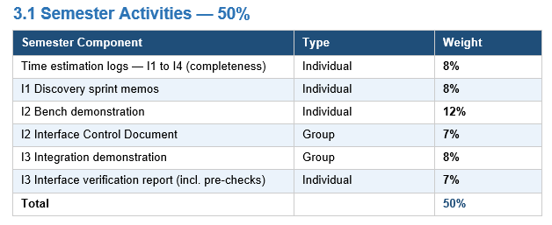
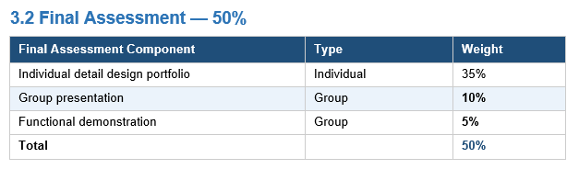
MARKS BREAKDOWN

Slide 10
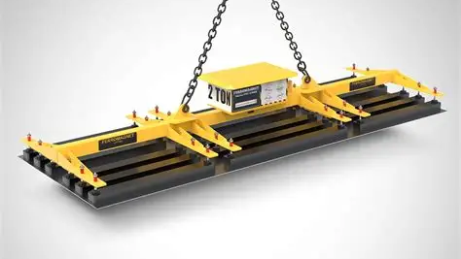
Project 2026 GANTRY crawl for sheet metal handling

Slide 11
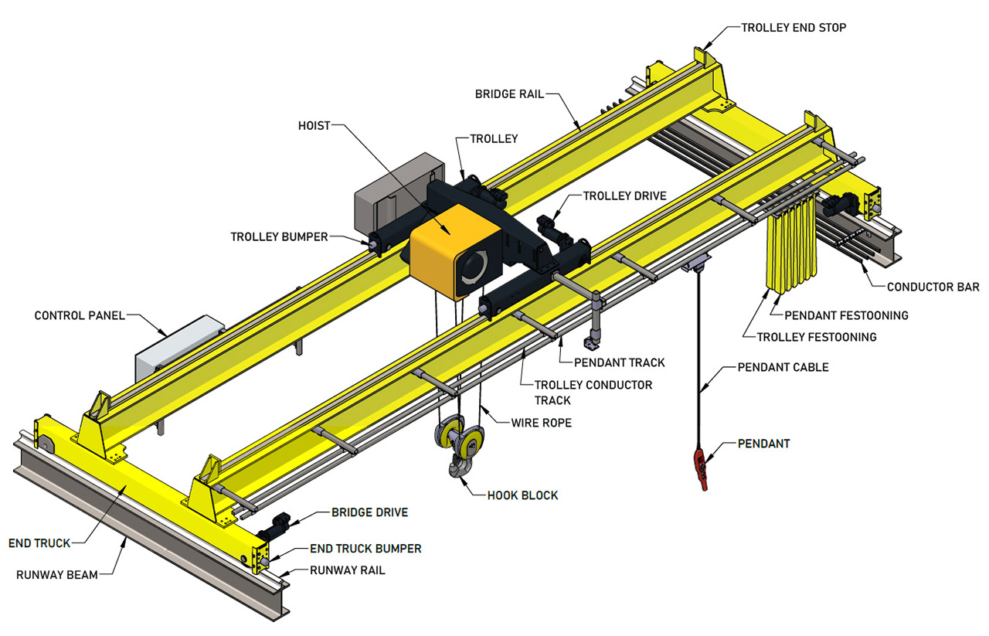
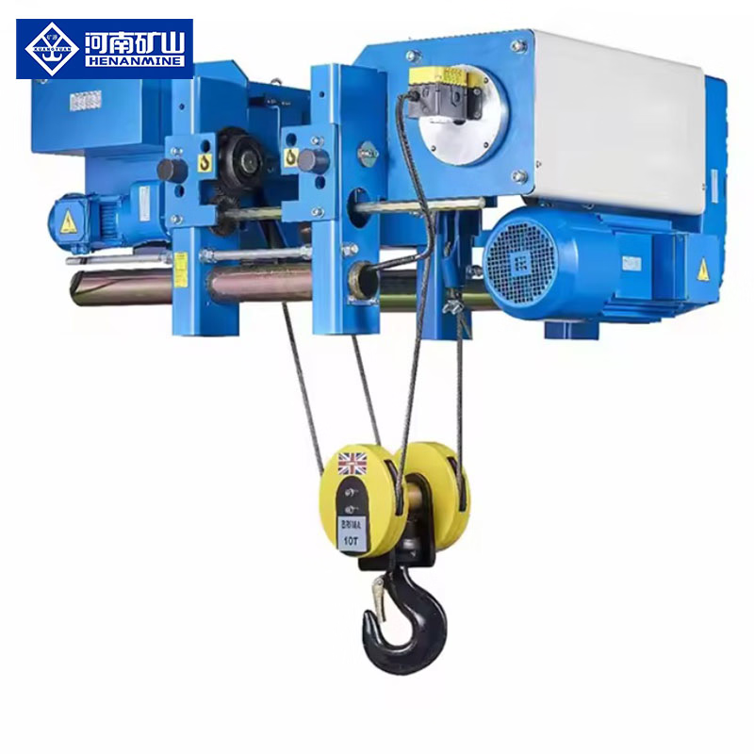
Project in 2025

Slide 12
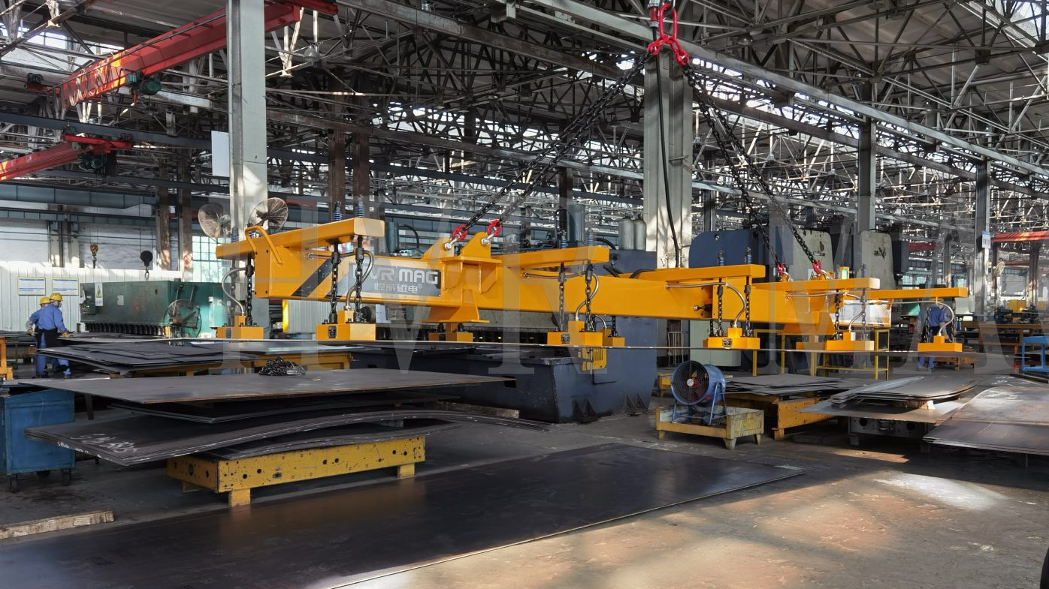
Project 2026 main use case
Metal sheets must be loaded into processing machines
Only ferrous metals
Magnetic attachment
Sheets must travel parallel to the ground
Sheets must be transported up and over obstacles
Dangerous environment necessitates remote control

Slide 13
Practically speaking
MINIMAL SET
MECHATRONICS
Lateral Movement
ELECTRICAL
COMPUTER
Control Electronics
Drive Electronics (incl protection)
3 phase Induction
Motor
Hoisting and Spooling
Magnetic attachment mechanism
Remote Control (PC based)

Slide 14

Looks expensive…
Some components are provided
STM32 MCU, wireless module, buttons, motor
Manufacturing (mostly free of charge)
In-house 3D printing, laser cutting (wood, plastic)
PCB manufacturing (limits apply, electrical students)
Fabrication space (cut, weld, drill, assemble)
Design driven components ordered
Budget of R5000 / group

Slide 15

Module requirements
Heterogenous Groups, 6 students/group (core and optional blocks)
EEII327
Electronics II, Electrical Machines II, Embedded programming
MCTR327
Electronics, Strength of materials, Systems modelling, embedded programming
REII327
Electronics, Computer programming, embedded programming
No timetable clashes are allowed

Slide 16

Module presentation

Slide 17

In practice
Weekly lectures
Wednesdays 14:30
Attendance is mandatory
Friday’s QnA / AdHoc
Weekly activities
Async / online
Group / individual
Implementation / Lab work
Personal responsibility

Slide 18
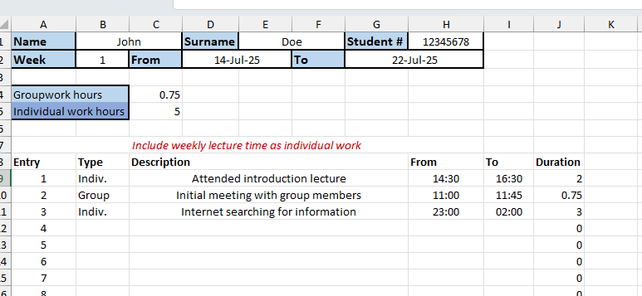
Why WORK logs?

Slide 19
Air purifier control board (example)
This is not a detailed example (contractual reasons)
Scope of work is indicative
Quality of work expected in Engineering Design
Indicative of a sub-system (thus 1 group member’s work)

Slide 20
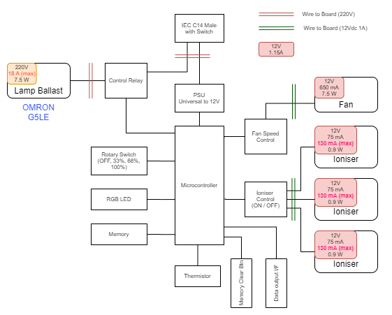

architecture

Slide 21
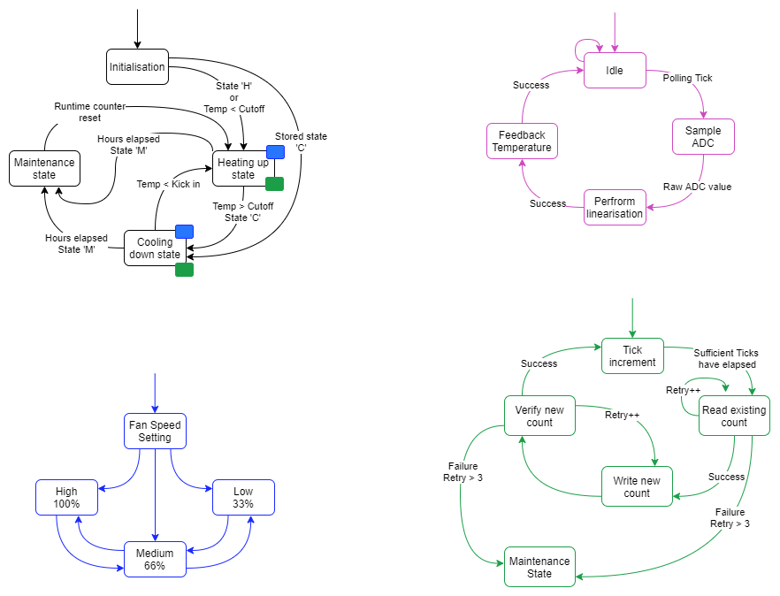

Firmware

Slide 22
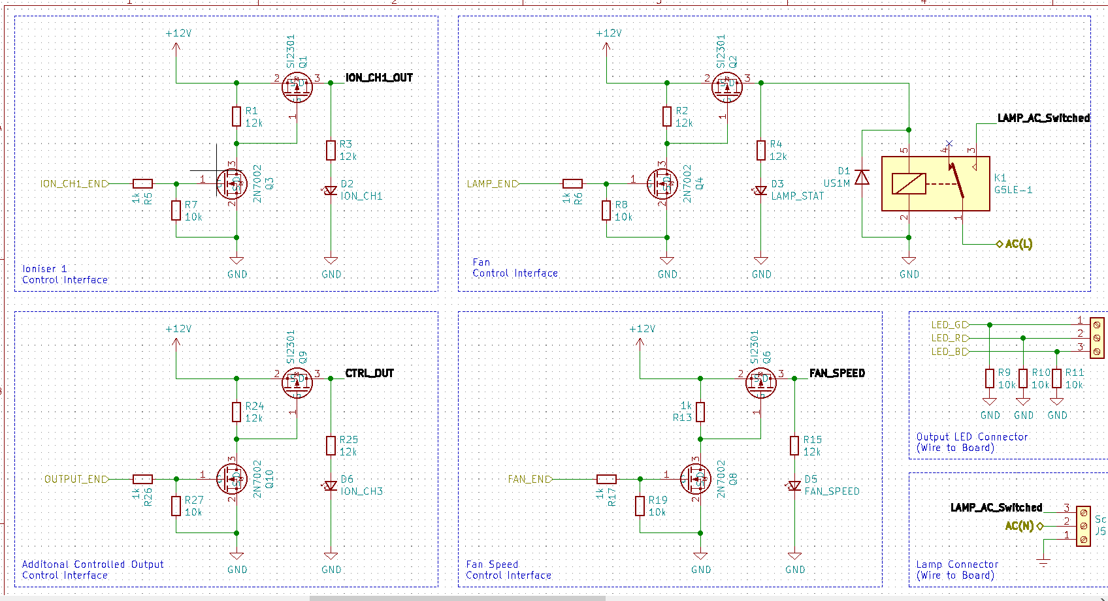

schematics

Slide 23
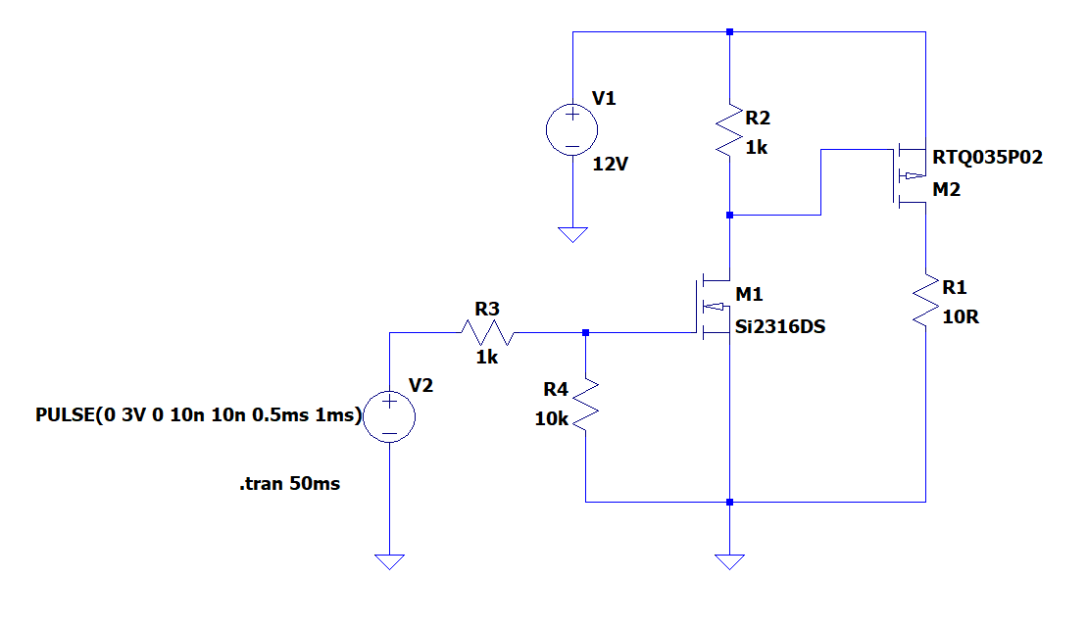

Some low-level details

Slide 24
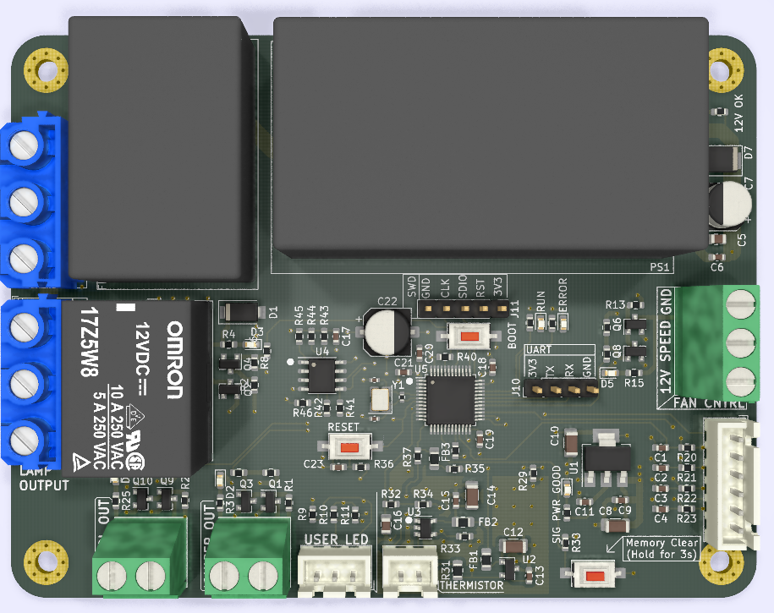
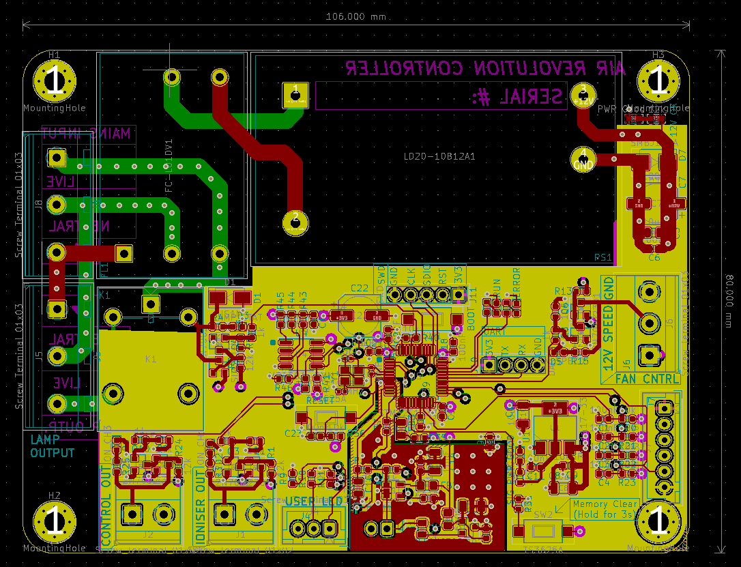
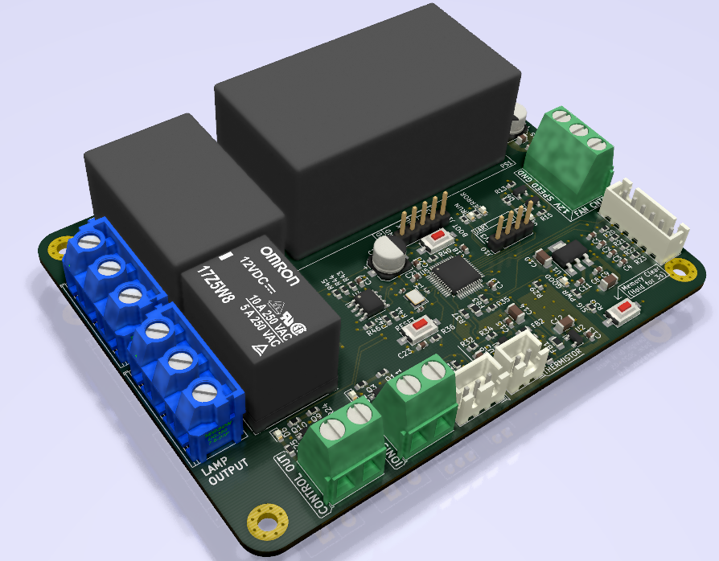
FINAL PCB Layout

Slide 25
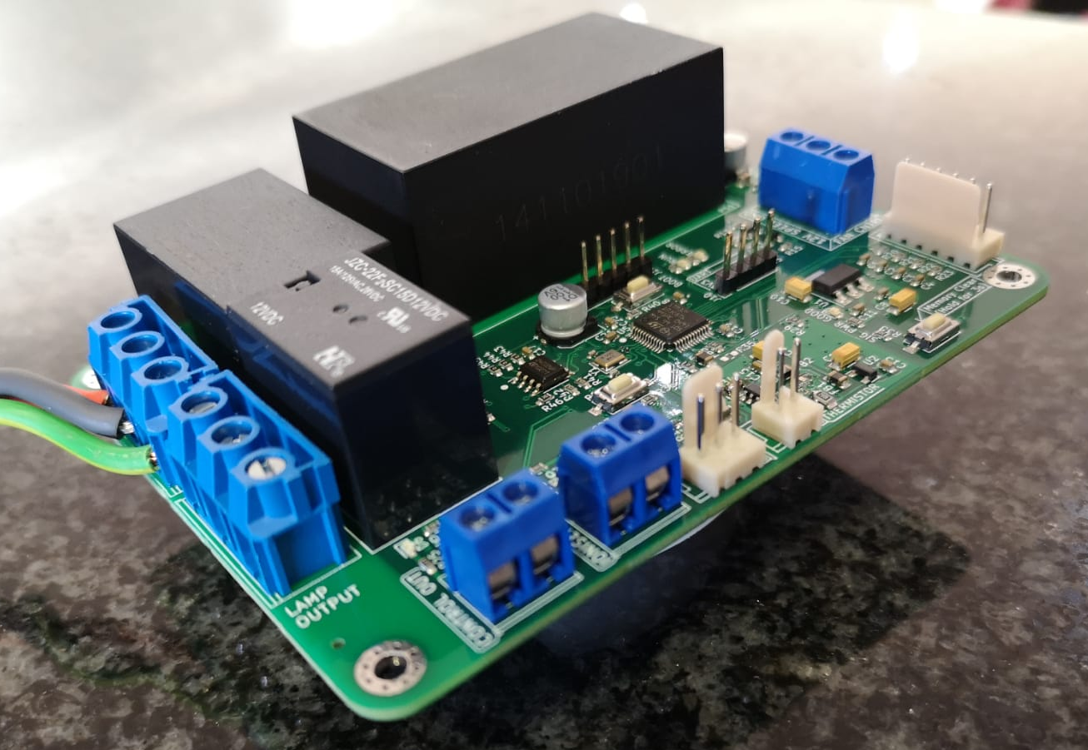
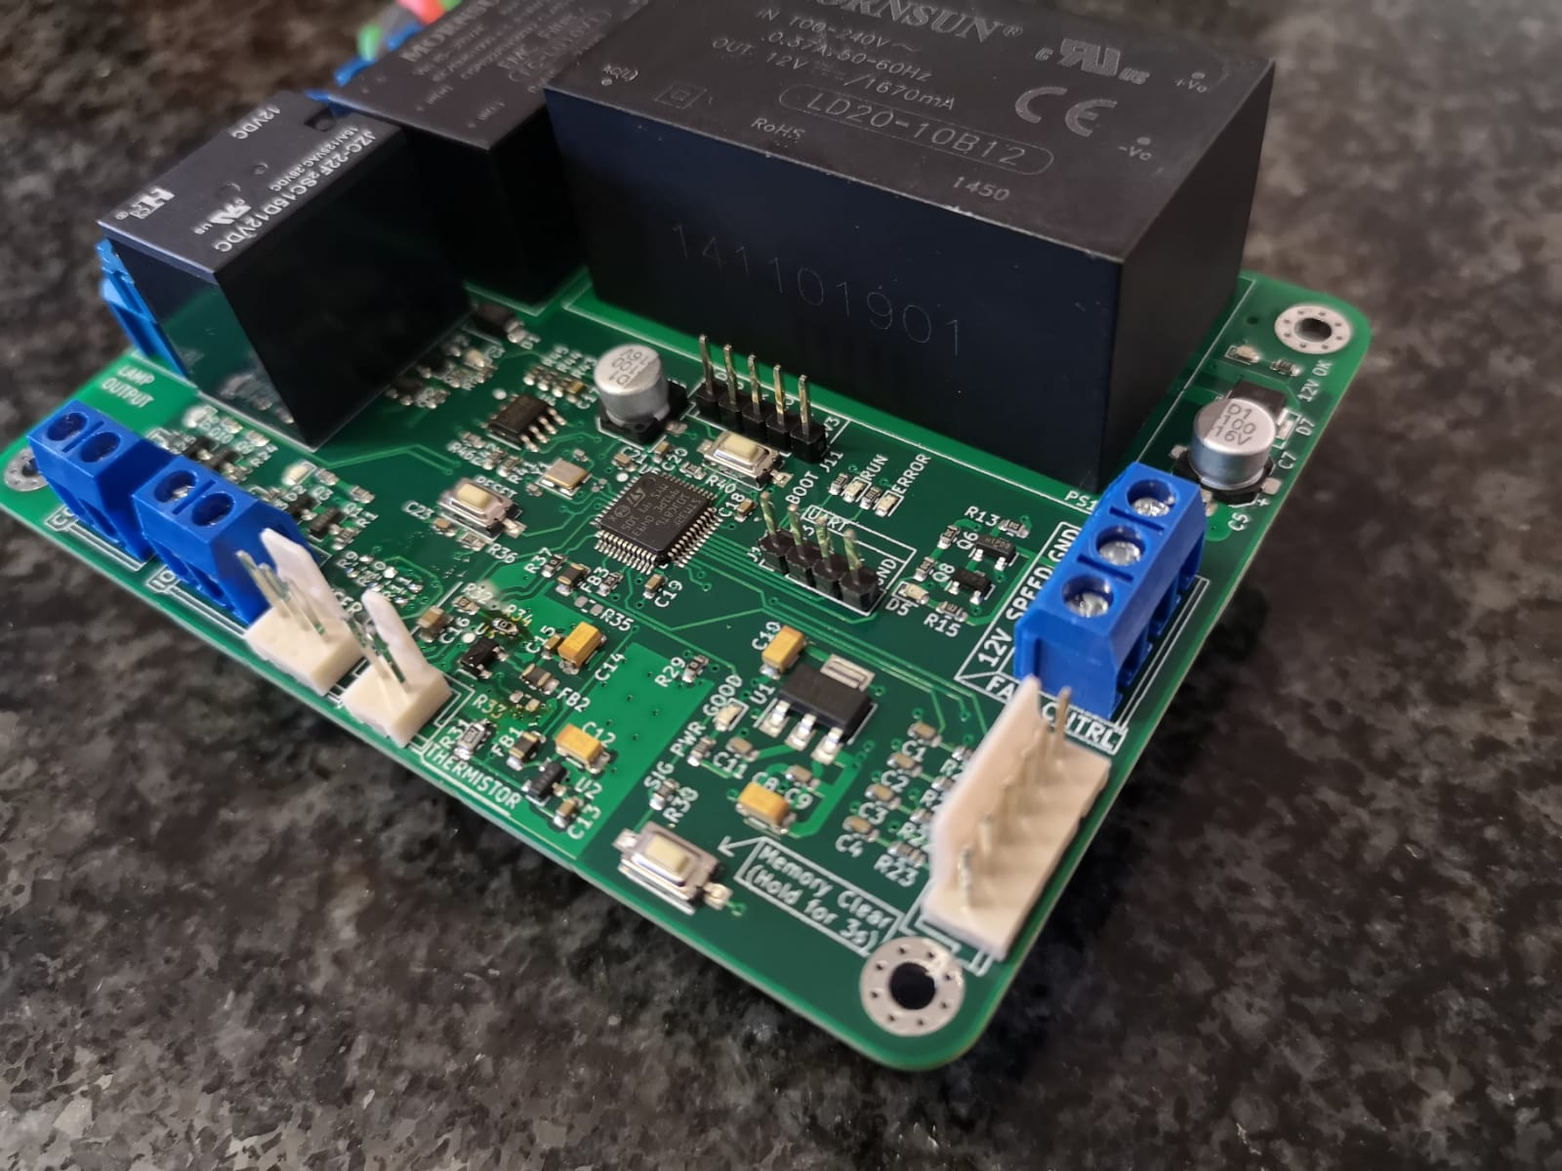



Prototype manufacturing run

Slide 26
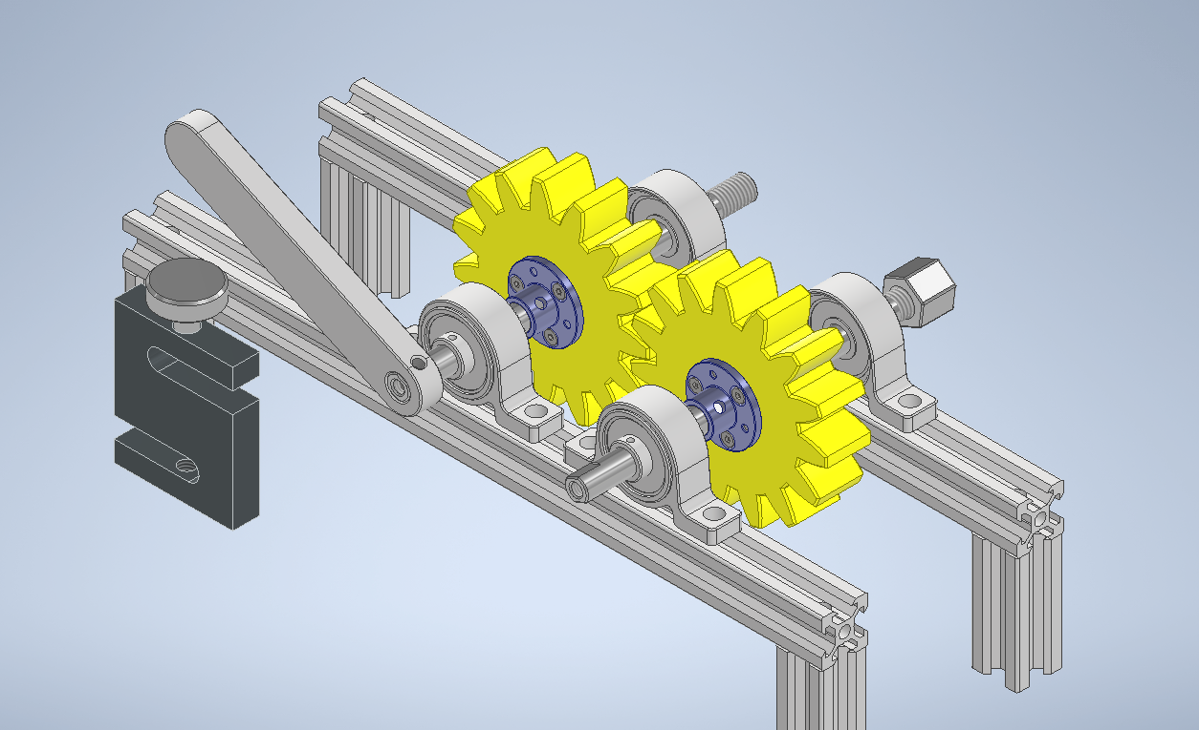
CAD MODELS

Slide 27
Wrapping up
Engineering design is a new thought process
01
This is tricky to master
Looks MUCH easier than it is
Physical prototypes MUST be functional
+
Public exhibition
02
Group work results when an entire group of individuals work independently.
03
Work hard and expect success!
04

Slide 28

Class activity
Notify lecturer TODAY if you are not participating in engineering design.

